Slide 1
Credit Risk Model in Loan Data

Slide 2
​OBJECTIVE
Predict the probability of default on a loan.
Identify the factors that affect the risk of default.
Provide insight to financial institutions in making credit decisions.
DATA CONTEXT
Dataset: Lending Club Data from 2007-2014
Data Source: Kaggle
Dataset Size: 466285 rows x 75 columns
Target Variable: 'good_bad' (0: Pay Success, 1: Fail to Pay)

Slide 3
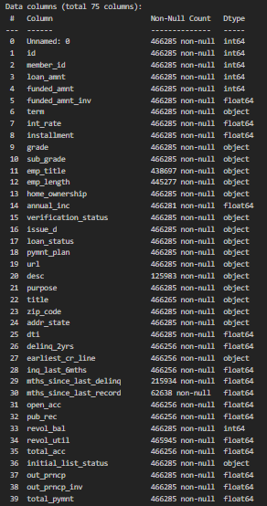
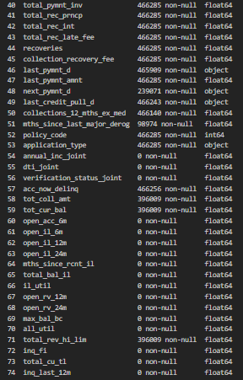
DATASET
The following is loan data that we will analyze to create a credit risk model.

Slide 4

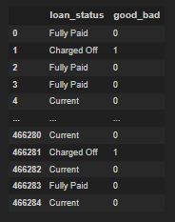

TARGET VARIABLE
loan_status column
Bad or good loan, need column "loan_status"
Bad is defined as 1, and the remaining good is 0.
Bad: 'Charged Off', 'Default', 'Late (31-120 days)', 'Late (16-30 days)', 'Does not meet the credit policy. Status:Charged Off’
Good: Else

Slide 5
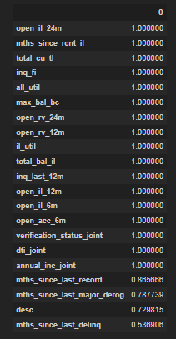
MISSING VALUES
Columns with missing values above 50% are better removed because even if you try to fill them with media, mean or other techniques for missing values it will produce values that are less accurate.
Due to the large number of rows and columns, it is important to check for missing values so that the model can more easily predict based on these columns

Slide 6
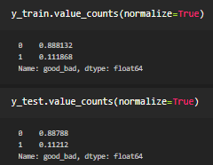
DATA SPLITTING
Train Dataset: train a machine learning model, by learning from the patterns in this Train Data.
Test Dataset: evaluates the machine learning model, whether when the model predicts a new data point, namely whether the test set is accurate or not.
Done by dividing into 80% TrainSet and 20% TestSet.
Because, in this case there is an imbalanced class distribution, because there are very many 0 values and few 1 values. Therefore, we cannot use accuracy_score to measure the performance of our model in this case, because it might be misleading.
Here we will look for the best threshold using ROC and Confusion Matrix will be used to evaluate the model.

Slide 7
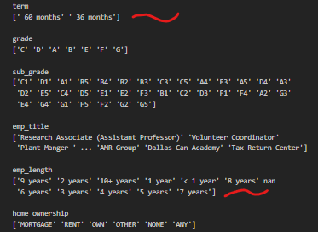
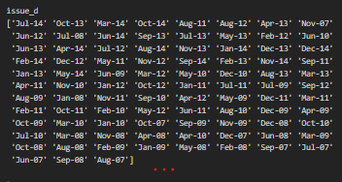
DATA CLEANING
It can be seen that the column,
term : should be numeric
emp_length : should be numeric
issue_d, earliest_cr_line, last_pymnt_d, next_pymnt_d, last_credit_pull_d : should be datetime
Category or non-numeric column

Slide 8
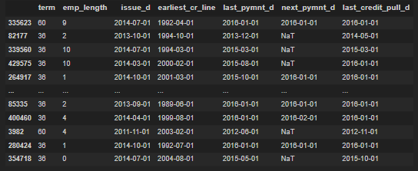
DATA CLEANING
After data cleaning from previous data, the emp_length column is based on data information in the LCDataDictionary, namely "Length of work in years. Possible values are between 0 and 10 where 0 means less than one year and 10 means ten years or more .“ The data is generated as follows.

Slide 9
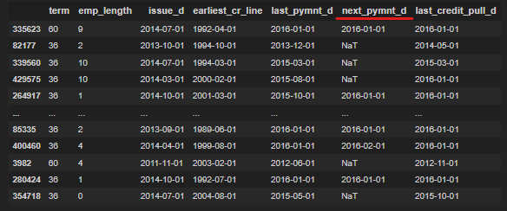
FEATURE ENGINEERING
Generates a new column from existing columns.
For the next_pymnt_d column, namely the next payment time is not too influential here even though when to pay. So it can just be deleted, and the data used is a column other than the next_pymnt_d.

Slide 10
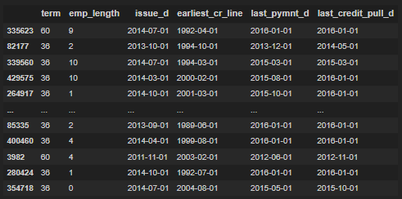
FEATURE ENGINEERING
Setelah dihapus
However, to enter the data into the model, it is necessary to convert it into numbers for columns that are not yet numbers.

Slide 11
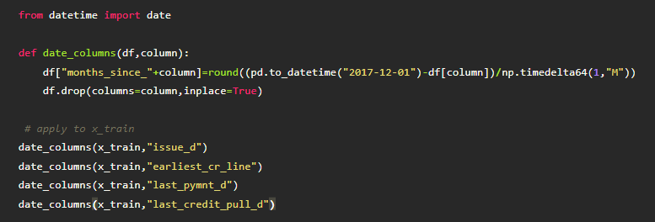
FEATURE ENGINEERING
Here the reference will be used, namely the time after the last date of the loan evaluation. Then, the time taken is 2017-12-01 as a reference. That way new columns will be created that come from the difference from 2017-12-01 to the other columns.
"months_since_issue_d", which contains the difference in months between "2017-12-01" and the loan date given in month format.
"months_since_earliest_cr_line", which contains the difference in time of month between "2017-12-01" and the date the first credit line was created.
"months_since_last_pymnt_d", which contains the difference in months between "2017-12-01" and the last payment date.
"months_since_last_credit_pull_d", which contains the time difference in months between "2017-12-01" and the last credit evaluation date.

Slide 12

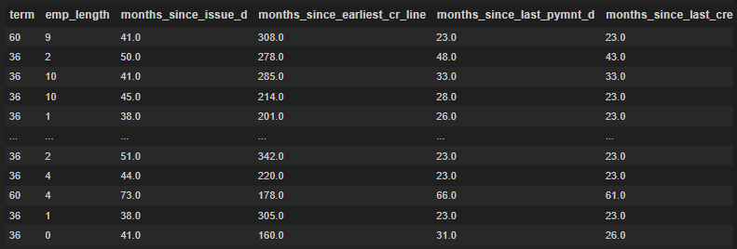
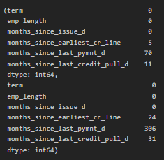
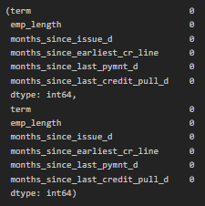

FEATURE ENGINEERING
Become…
When checked, it turns out that there are still missing values, so the missing values are filled in.

Slide 13
MODELLING
Target:
1 --> (Probability Approaching 1 ) Default (Bad Loan)
0 --> (Probability Close to 0 ) Successfully Pay (Good Loan)
As a result of the imbalance class distribution, where if accuracy is used to measure the accuracy of a model, then the model that classifies all test samples to "0" will have very good accuracy. Of course this model will not provide valuable information.
Here used Logistic Regression Model. Then a search for the best threshold will be carried out so that the resulting model is more accurate than using the default threshold of 50% in logistic regression. The ROC method is used to find the best threshold. After that, a confusion matrix will be used to measure the performance of the model.

Slide 14
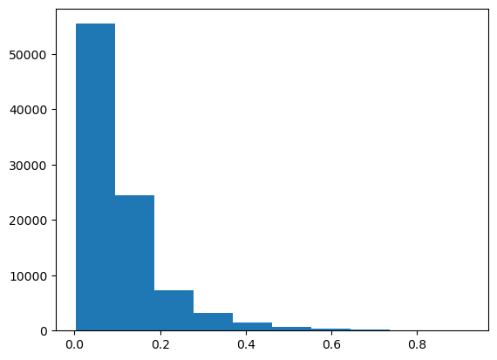
MODELLING
By using the predict_proba() method, the class 1 probability (bad loan/default) is obtained in the following graph.
From here we can find the best threshold by means of ROC and determine the Youden index so that the best threshold is 0.09.
If we predict a loan above 0.09 (9%) it is likely that the loan will default (class 1).
However, if it is below 0.09 (9%), it is likely that the loan will be successful (class 0).

Slide 15
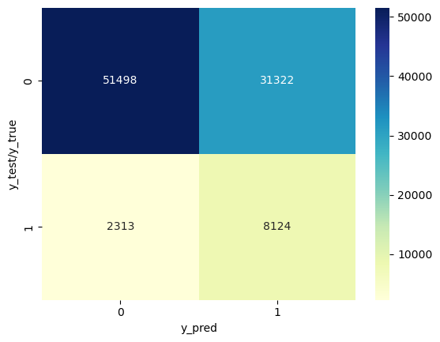
MODELLING
Then do the confusion matrix, the following results are obtained:
TP (True Positive) (8124) : Positive data that is predicted to be true. The borrower defaults (class 1) and the model predicts default on the borrower (class 1).
TN (True Negative) (51498): The predicted negative data is true. The borrower pays off (class 0) and the model predicts the borrower pays off (class 0).
FP (False Positive) (31322): Negative data but predicted as positive data. The borrower succeeds in paying (class 0) and the model predicts the borrower defaults (class 1).
FN (False Positive) (2313): Positive data but predicted as negative data. The borrower defaults (class 1) and the model predicts the borrower will repay (class 0).

Slide 16
MODELLING
Koefisian dari model
term: the longer the timeframe for repaying the loan, the higher the probability that he will default.
emp_length: the higher, the lower the probability of default.
months_since_issue_d: the longer the disbursed money, the lower the probability of default.
months_since_earlist_cr_line: the longer it is an hour since the credit creation date, the lower the probability of default. (If the age of the credit line is old, it means that the probability of default is lower).
months_since_last_pymnt_d: the longer the last payment, the higher the probability that he will default.
months_since_last_credit_pull_d: the longer the last credit evaluation, the higher the probability that he will default. (So we have to evaluate it routinely, because if we routinely carry out evaluations, it means that the difference between the last evaluation date and the current date is getting smaller, therefore, the probability that he will fail to pay will be smaller).

Slide 17
REFERENCES
https://www.kaggle.com/datasets/devanshi23/loan-data-2007-2014
https://socs.binus.ac.id/2019/12/26/imbalanced-dataset/
https://datasans.medium.com/memahami-roc-dan-auc-2e0e4f3638bf
https://ksnugroho.medium.com/confusion-matrix-untuk-evaluasi-model-pada-unsupervised-machine-learning-bc4b1ae9ae3f

